Slide 1
SAE Battery Standard Steering Committee
Guidance Documents Supplied to NAATBatt International
for Committee Work
September 2, 2020
Robert L. Galyen

Slide 2

Battery Standards Steering Committee
BATTERY STANDARDS STEERING COMMITTEE
Started – 2009
Committee Membership
>290 Individual Participants
>160 Companies
  OEM’s
  Suppliers
  Government
  Academia
23 Subcommittees
SUPPORT
PRODUCT SPECIFIC
4) Battery Transport
12) Battery Testing Equipment
2) Battery Standards Testing
1) Battery Safety
13) Battery Terminology
3) Battery Labeling
16) Start-Stop Battery
17) Capacitive Energy Storage
9) Battery Standards Future Energy Storage Systems
5) Battery Size Standardization
NEW COMMITTEES
24) Electric Vehicle Battery Service
20) International Battery Interface
6) Starter Battery
8) Battery Standards Electronic Fuel Gauge
COMPONENTS & MATERIALS
LIFE MANAGEMENT
23) Battery Systems Adhesives-Sealants-Heat Transfer Materials
21) Battery Thermal Management
INDUSTRY SPECIFIC
18) Battery Field Discharge & Disconnect
7) Truck Batteries
10) Battery Recycling
11) Small Task Oriented Vehicle Batteries
19) Battery Systems Connectors
14) Battery Materials Testing
22) Bus Battery
15) Secondary Use

Slide 3
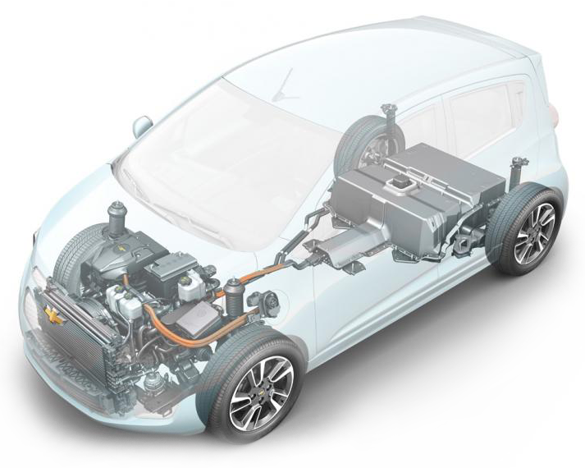
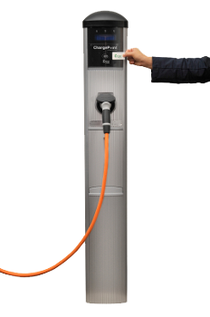
BATTERY STANDARDS COMMITTEE DOCUMENTS
10 Active
15 Under Revision
2 Stabilized
7 New in Progress
  Battery Life Assessment Testing: J240, J2185, J2288, J2801
  Battery Testing Equipment: JXXXX
  Battery Performance Rating: J1798
  Battery Size, Identification & Packaging: J1797, J3124, J2981
  Sealing, Adhesives, Thermal Management: J3073, JXXXX
  Battery Testing Methodologies: J537, J1495, J2758 , J930
  Future Battery Systems: JXXXX
  EV / Battery Fuel Economy & Range: J1634, J1711, J2711
  Battery Materials Testing: J2983, J3021, J3042, J3159
  Functional Guidelines: J2289
  Vibration: J2380, J3060
  Battery Labeling: J2936
  EV Charging:
  J1772, J1773, J2293, J2836, J2841, J2847, J2894, J2931
  Battery Recycling: J3071, J2974, J2984
  Battery Safety: J2929, J2464, J2946
  Battery Transport: J2950
  Capacitive Energy & Start/Stop: J3012, J3051
  EV Battery Safety: J1766, J2344, J2910, J2990
  Battery Terminology: J1715/2
  EV Terminology: J1715

